Slide 1

Online Shoppers Purchasing Intentions - Team MTB
Brian Doyle, Tony Hollaar, and Monika Sivilli
Notes:
We are team MTB and we will be discussing online shoppers purchasing intention based on data gathered about their online browsing.

Slide 2



Who are we
Who is our
audience
Why...
Team MTB
Digital Marketing Teams
Notes:
Similar to last semester, we decided to create a storyline in order to add real world value to our work.
Who are we: Our company name is Team MTB and We are a Marketing Analytics Consulting Firm looking to understand and analyze online shopping habits, more specifically, how habits contribute to customers purchasing decisions. With the coronavirus pandemic making online marketplaces more essential than ever, we think this is an opportunity to help companies improve their websites.
Who is our audience: Our audience or our client base consists of digital marketing teams in the e-commerce environment. We help companies looking for assistance with their customer knowledge, website and online sales.
Why: We help companies make smarter, more efficient and better economic marketing decisions. Especially in today’s current economic condition with retail completely closed, companies are looking to enter the e-commerce space or expand their presence. Our company is in higher demand now than ever before. Companies are stressing the importance of cutting costs and we can help them do that with our analytical tools.

Slide 3

Team MTB’s Questions
Main Question:
What drives potential customers to make a purchase?
Sub Questions:
1. Which model is the best predictor for determining if a customer will make a purchase, or not, based on the AUC and weighted average F1 score?
2. Is investing in Google Analytics (Bounce Rate, Exit Rate & Page Value) worth the price?
3. Which features, besides Google Analytics features, contribute most to customers’ purchasing behaviors?
4. Does seasonality play a role in customer’s purchasing decision?
Notes:
We aimed to use the provided dataset to answer the following questions. We believe the answers to these questions are of value to our clients, as they will help the companies improve their understanding of customer shopping habits and thus increase sales.
We chose to center our process around finding out which features in the dataset are most important in determining whether or not a customer makes a purchase. The more our clients know about their online customers’ browsing habits, the more adjustments they can make to increase the likelihood of selling their product.

Slide 4
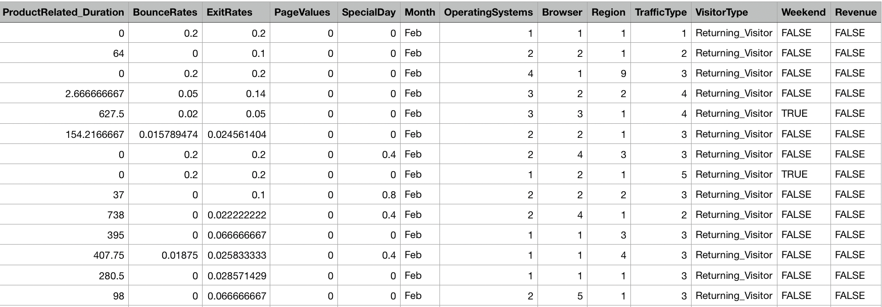
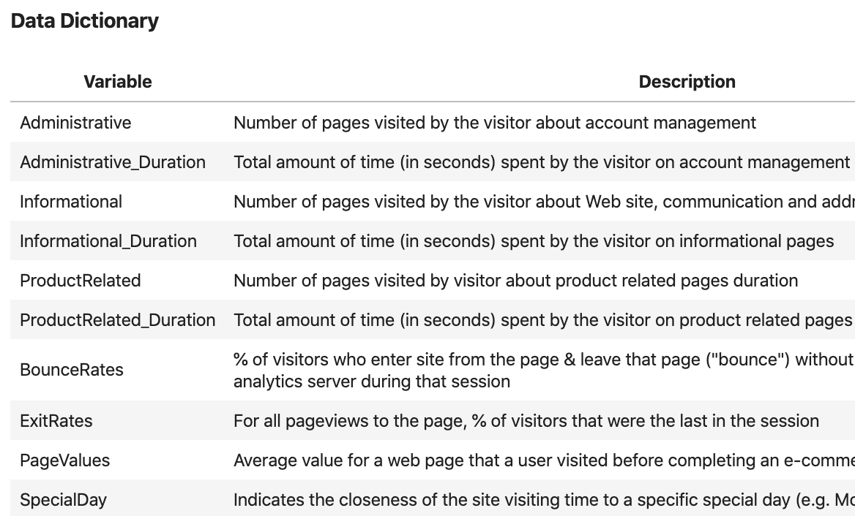
Our Resources
Notes:
To answer these questions, we used the dataset shown.
This is a quick view of our data and our data dictionary just to give an idea of what we were working with.
On the next slide, we have more in depth descriptions of the dataset.

Slide 5
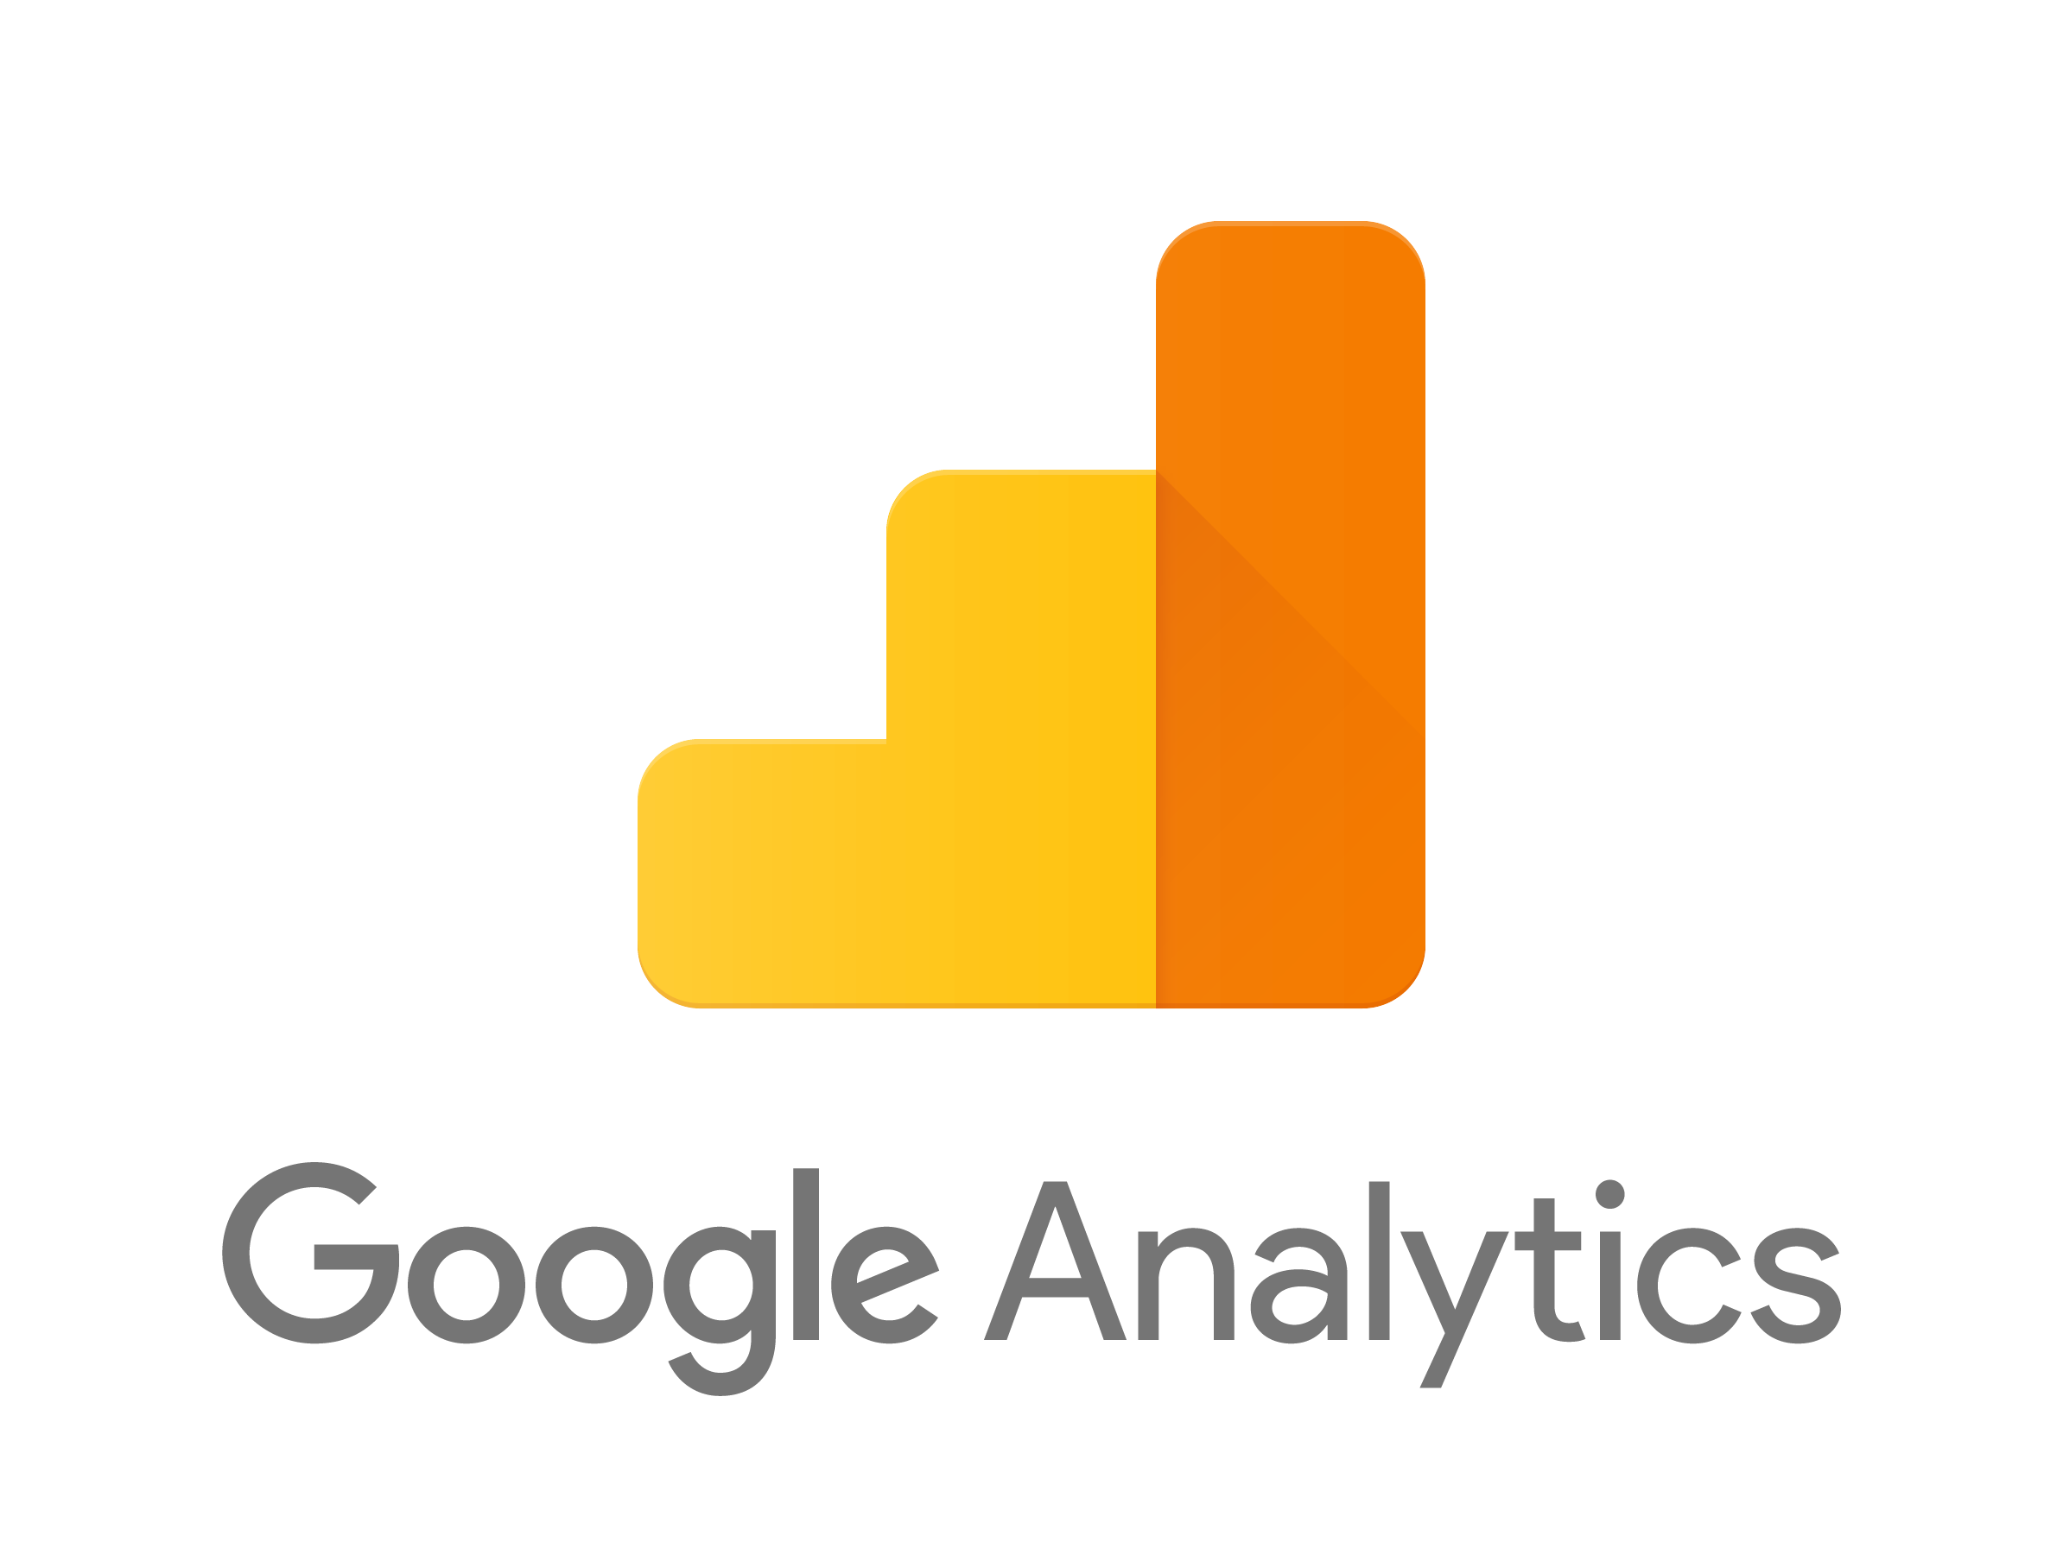
Our Resources
12,330 Rows & 18 Features
10 Numerical Attributes:
Administrative, Administrative duration, Informational, Informational Duration, Product Related, Product Related Duration, Bounce Rate, Exit Rate, Page Value, Special Day
8 Categorical Attributes:
Operatings Systems, Browser, Region, Traffic Type, Visitor Type, Weekend, Month, Revenue
Notes:
Overall, the dataset consists of 12,330 rows about consumer's online behaviors and purchasing tendencies. Each session belongs to a different user over a 1-year period to avoid any tendency to a specific campaign, holiday, user profile, or period. The dataset consists of 10 numerical and 8 categorical attributes. The Revenue variable is often used as the class variable.
Lastly, Google Analytics accounts for 3 features. Bounce Rate, Exit Rate & Page Value

Slide 6
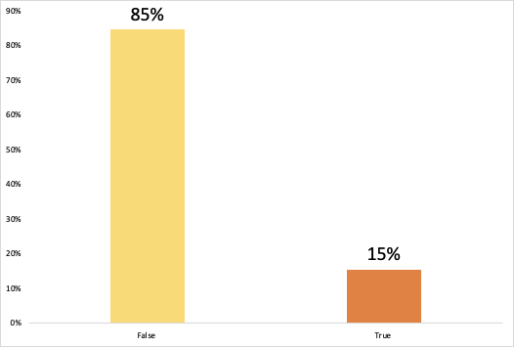
Highlights of EDA
Online Shoppers Buying vs. Not Buying
No “missing” values
One hot encoding
Data is highly skewed
Notes:
For the next step, we wanted to look more closely at the data. We performed exploratory data analysis also known as EDA. First, we looked into revenue:
Graphed our target variable, Revenue, and found that the data is unbalanced. 84.53% of the web users did not make a purchase in an online session. Shown as False(yellow) on the graph.
15.47% did make a purchase. Shown as True. So, in a random guess with our Baseline Model we would only be correct 15.47% of the time. Therefore, we needed to perform over and under sampling (to adjust class distribution of the dataset)
One hot encoding on categorical features ( This is a process by which categorical variables are represented as binary vectors, making them better for prediction purposes)
All features are highly skewed, therefore, normalization is necessary in the data preparation phase

Slide 7
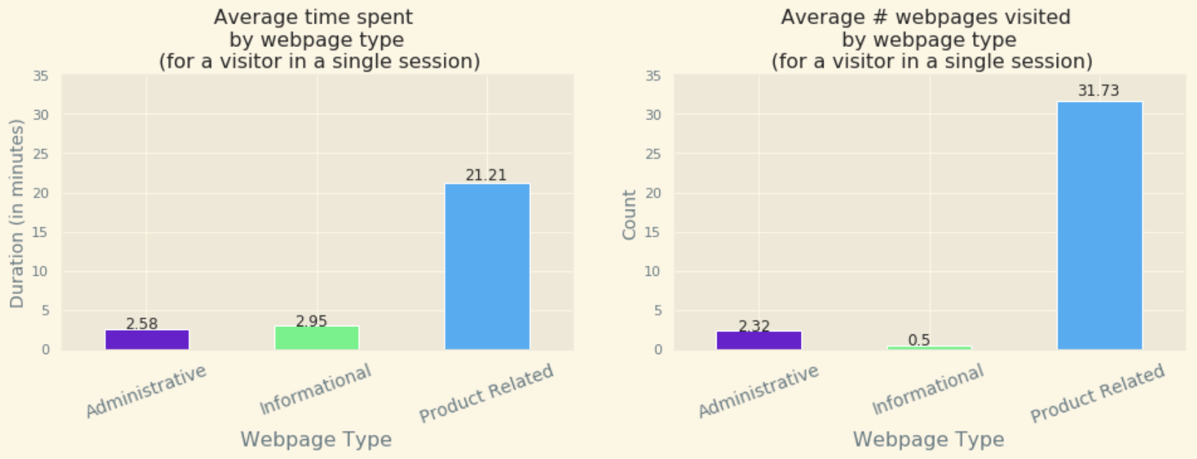
Highlights of EDA - Product Related Pages
Notes:
Next, we looked into webpage types:
We found that:
On average, users visit the highest number of Product Related webpages and spend the most time (21.21 minutes) on these pages compared to administrative and informational
So something to keep in mind for our clients. Since users spend so much time on Product Related web pages, they should be of high priority and run as efficiently as possible.
The right histogram shows the duration spent on product related pages against Revenue. Our finding show that ProductRelated_Duration is much smaller for visitors that made a transaction vs visitors that did not make a transaction →
Minutes vs number of pages visited
(click for zoomed image of graph) Here’s a closer image to show the low values for exit rate

Slide 8
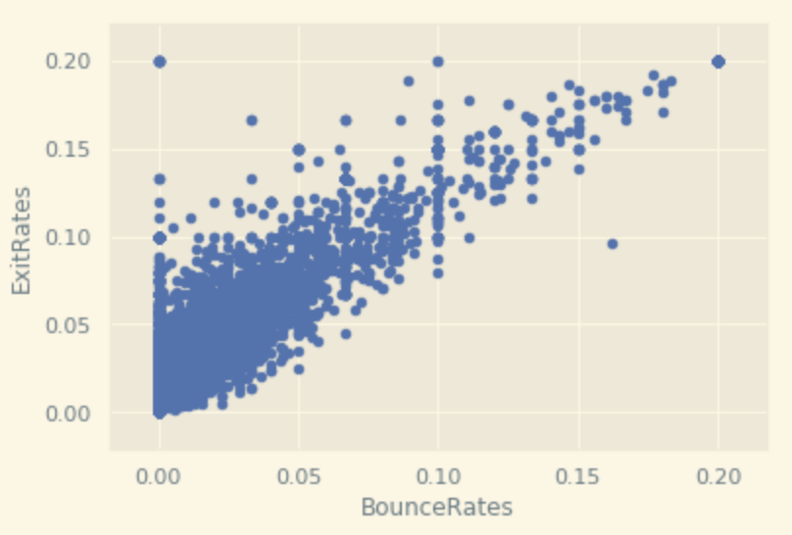
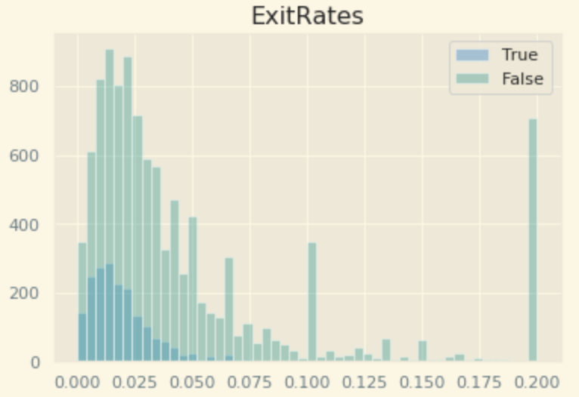
Highlights of EDA - Bounce vs. Exit Rates
Highly positively correlated (.913) with a linear pattern
Distribution of Exit Rates
Notes:
Next, we looked into the relationship between bounce rates and exit rates:
We found that there was an Average exit rate of 4.31% and an average bounce rate of 2.22%. A successful website with high sales should have both a low exit and bounce rate. Bounce rates are typically between 10% and 50% with 10% being very good. So, a bounce rate of 2.22% was outstanding. An average exit rate of 4.31% is also very good.
As seen in the scatter plot on the left, we found that these features are HIGHLY positively correlated. However, we believed they were very important to our analysis and therefore, we combined them in our feature engineering section (which we will discuss later on)
The right graph shows the distribution of exit rates with revenue. True(blue) indicates a purchase was made and false(green) indicates no purchase was made. There is clearly a higher distribution of consumers with higher exit rates who did not buy anything. Exit rates have less extreme outliers for consumers who buy something.
Other insights, when Page value is high, typically the exit & bounce rates are low.

Slide 9
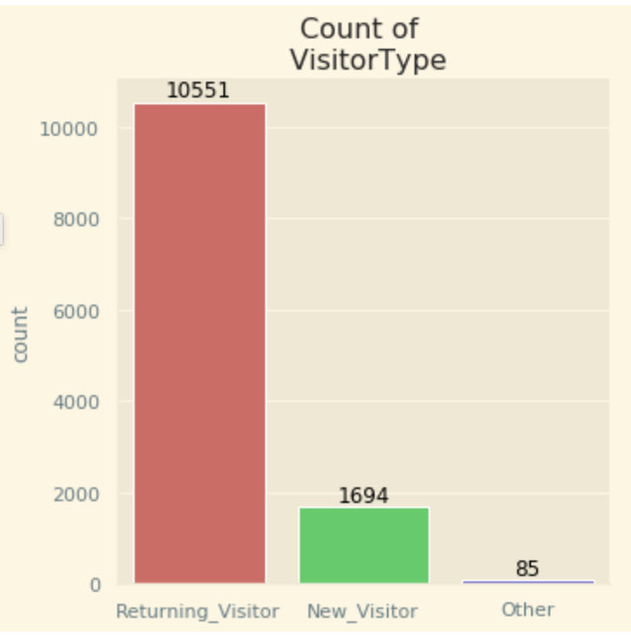
Highlights of EDA - Visitor Type
85% of the websites’ visitors are returning visitors
Only 14% of the websites’ visitors had never been on the site before
Notes:
VIsualized the counts of visitor types
Good sign that there is a high number of returning visitors, but it might be a good idea to invest in ways to attract a higher volume of new visitors.
(advertising, social media, etc)

Slide 10
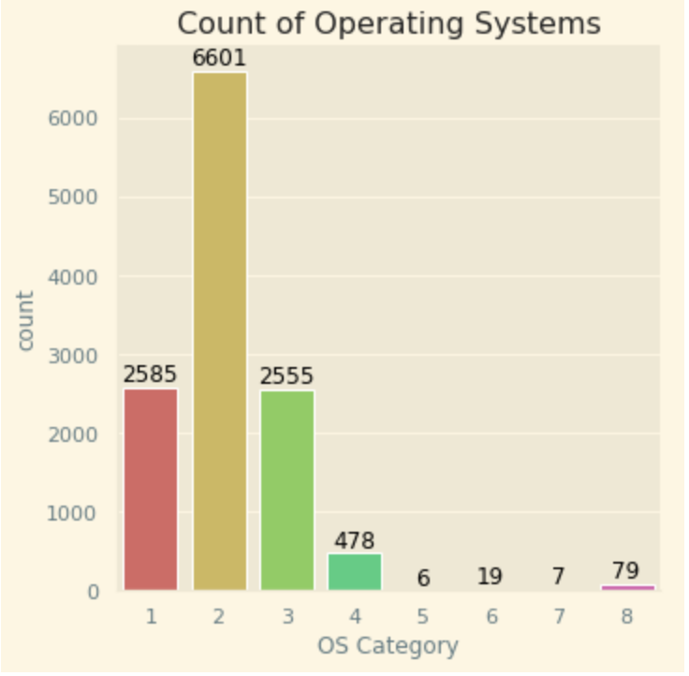
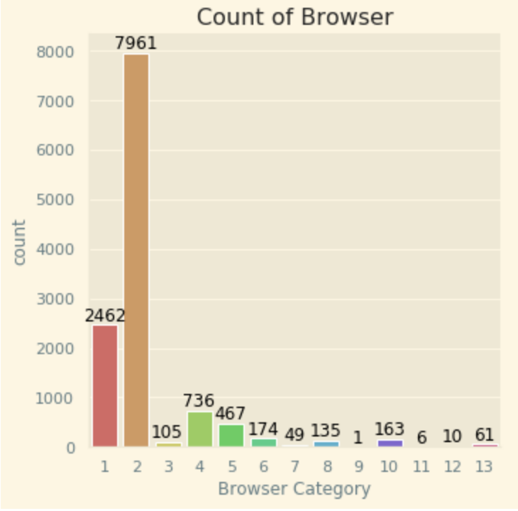
Highlights of EDA - Operating System & Browser Type
53% of website visitors use operating system “2”
64% of website visitors use browser “2”
Notes:
-Visualized counts of operating system and browser type
- Something to keep in mind that most customers are using Operating System 2 and browser 2. Important that the website is compatible with those.

Slide 11
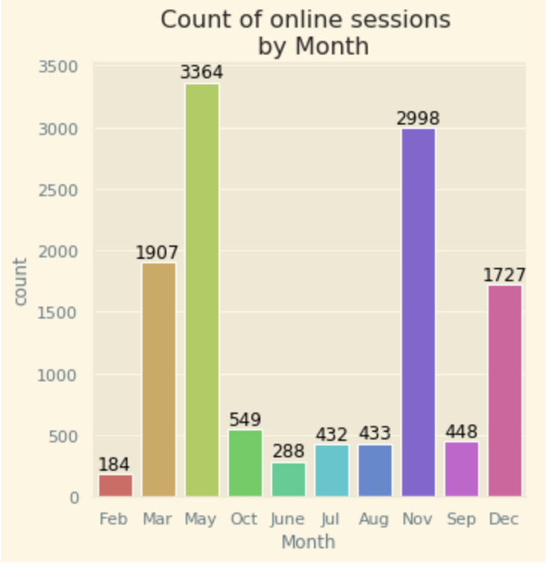
Highlights of EDA - Months
Website traffic is heaviest during the month of May, making up 27% of total yearly visits.
The month with the least traffic is February, with only 1% of total yearly visits.
Notes:
Visualized the counts of online sessions by month
May: Mother’s Day, Spring sales, etc.
November: Black Friday
February: Post holidays, pre spring/summer period, shortest month

Slide 12
Feature Engineering
Perform calculations on highly correlated features & define new features :
Bounce & Exit Rates:
Average
Addition
Division
Percentage Change
Three types of Web pages (Product, Administrative & Informational):
Duration Per Page
Notes:
How we combined highly correlated features:
- BounceRates with ExitRates → combined these features by taking the average, addition, subtraction and percentage change row-wise. Later on our feature selection chose the Addition feature.
- ProductRelated with ProductRelated_Duration -- combine them duration pp
- Informational with Informational_Duration
- Administrative with Administratie_Duration

Slide 13
Breakdown of Pipelines
Pipeline 1:
Outlier IQR
Normalization
Standardization Z-score
Correlation
Binning
Feature Selection
Pipeline 2:
Standardization Min-Max
Normalization
Outlier Stdev
Correlation
Binning
Feature Selection
Pipeline 3:
Normalization
Outlier Stdev
Standardization Z-score
Correlation
Binning
Feature Selection
Notes:
The red coloring highlights the difference between each pipeline. We built on our pipelines from the last project where we used IQR or Standard Deviation for Outlier calculations. For standardization we either applied a min - max or z-score function to the continuous features.
For normalization we employed the yeojohnson powertransform
For binning we combined the months into quarterly binary one-hot encoded data

Slide 14
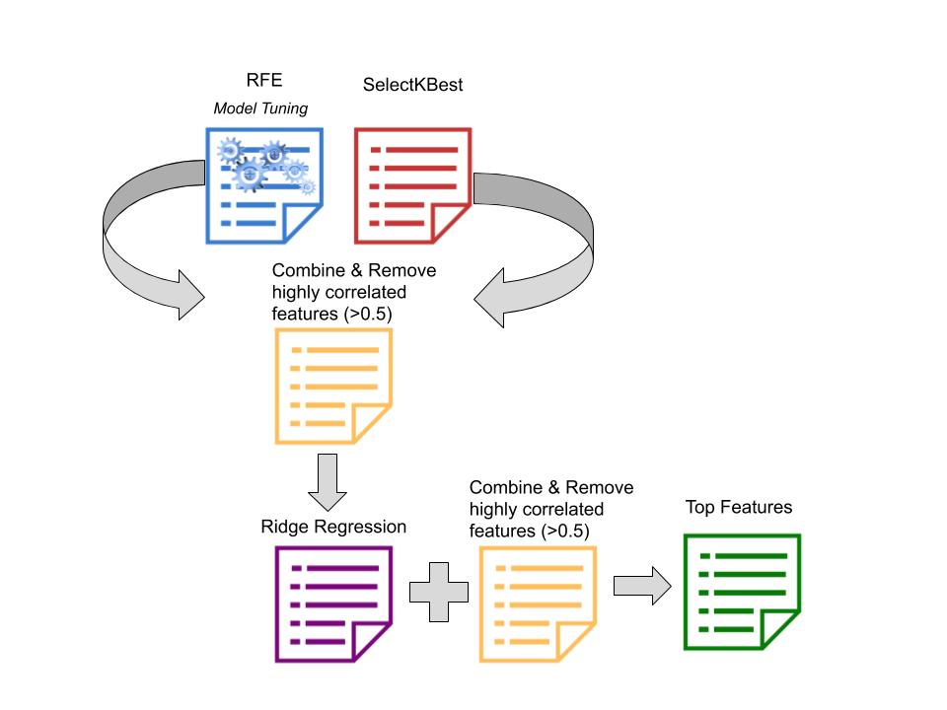
Breakdown of Feature Selection
Methods for Feature Selection:
Recursive Feature Elimination (RFE)
SelectKBest
Ridge Regression
Notes:
Three methods were run for feature selection. In the end, a combination of top selected features from each method was chosen.
Tony to explain more in depth about the process resulting in top features.
Click to show last step of Correlation Matrix -- We do a final check in the end to see if any top features are highly correlated. We do not want highly correlated features in our model otherwise it will positively skew / increase our results. → make new slide

Slide 15
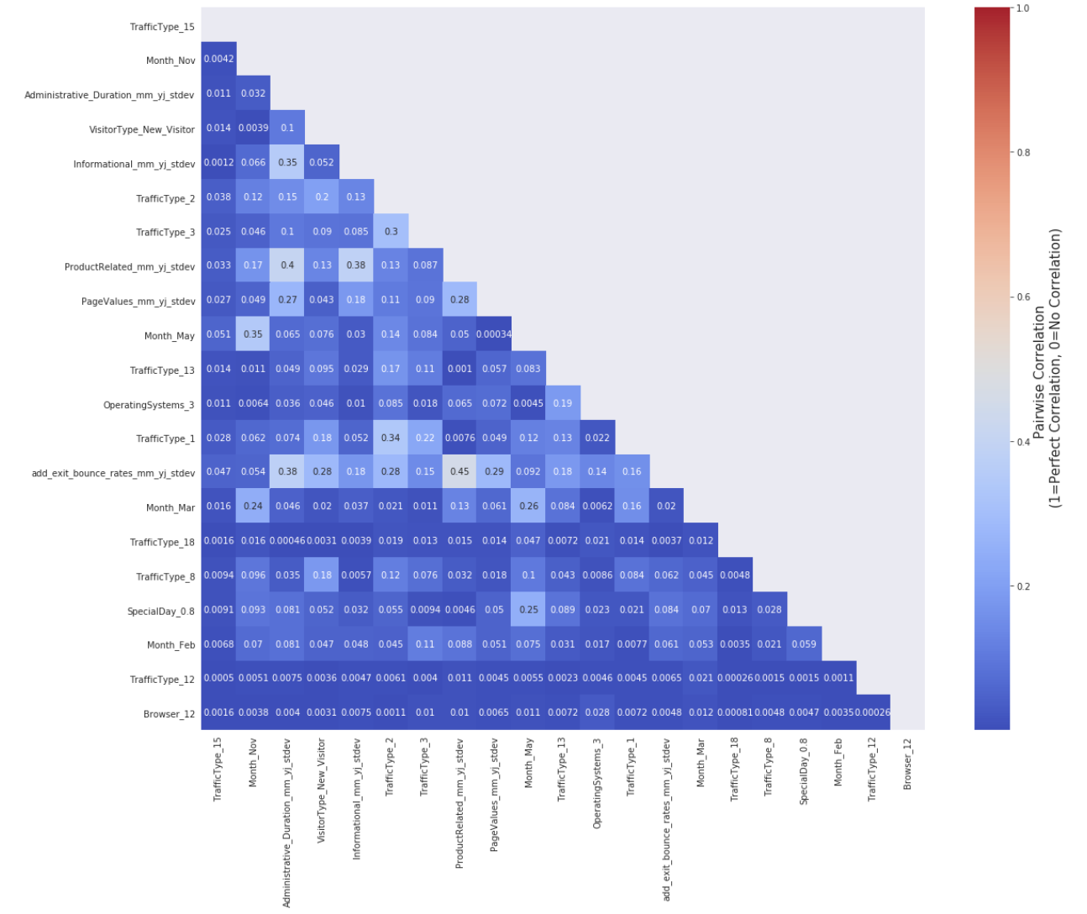
Correlation Matrix for Feature Selection
Inspect if Top Features are highly correlated
No!
Notes:
We do a final check in the end to see if any top features are highly correlated. We do not want highly correlated features in our model otherwise it will positively skew / increase our results.

Slide 16
Tools & Models
Models:
Baseline
Naive Bayes
Logistic Regression
XGBoost
Decision Tree Classification
Random Forest
Support-vector machine
Tools:
3 Pipelines for each model
Oversampling (SMOTE)
Undersampling (NearMiss)
Cross Validation (Kfold)
Model Tuning (Hyperparameters)
Feature Importance
Notes:
We only performed undersampling on our first couple of models and pipelines, but quickly learned the results were typically worse. Moving forward we focused only on Oversampling.
Note: Our pipelines have 22 features for pipeline 1, 21 features pipeline 2, 23 features for pipeline 3
We ran Model Tuning with Hyperparameters and Feature Importance on our top models and pipelines.
We used cross validation to prevent overfitting our model and estimate the skill of a machine learning model on unseen data

Slide 17
Baseline Model
Assumption: All online shoppers make a purchase!
 | Actual Positive | Actual Negative
Predicted Positive | 1908 | 10422
Predicted Negative | 0 | 0
Precision: 15.47%
Recall: 1
F1-score: 0.268
Weighted Average F1-score:
0.4079
Assumption: No online shoppers make a purchase!
 | Actual Positive | Actual Negative
Predicted Positive | 10422 | 1908
Predicted Negative | 0 | 0
Precision: 84.52%
Recall: 1
F1-score: 0.9161

Slide 18
Top Three Model Results
Model | Weighted Avg F1-score | AUC score
Logistic Regression | 0.8934* | 0.9239*
Random Forest | 0.8914* | 0.9233*
XGBoost | 0.8802* | 0.9239*
Statistical Test for Scores (t-test)
F1 and AUC scores are not significantly different between LR and RF
F1 scores are significantly different between RF and XGB, but AUC scores are not.
Variance in F1 scores is lowest for RF and highest for LR (0.00522 < 0.00893)
Variance in AUC scores is lowest for LR and highest for RF (0.007 < 0.0118)
* Cross validation results (KFold=10) ,
with optimized hyper-parameters.
Notes:
CONFIRM LATER Best results with cross validation using oversampling (SMOTE) based on the weighted avg F1-score and AUC score

Slide 19

Sub Question 1: Which model is the best predictor to determine if a customer will make a purchase, or not, based on AUC and weighted average F1 score?
Random Forest with Cross Validation, Oversampling & Model Tuning
Weighted Avg F1 Score .89
Average AUC .92

Slide 20
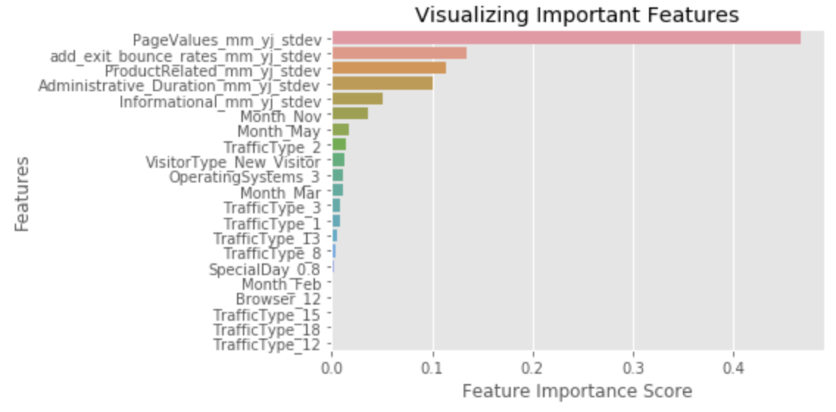

Sub Question 2: Is investing in Google Analytics (Bounce Rate, Exit Rates & Page Value) worth the price?
Consistent top features:
Page Value
Exit & Bounce Rates - Addition feature
Google Analytics is worth the investment
Notes:
Reoccuring top features:
In Random Forest they are the #1 and 2 features in feature importance → Page value account for 46% of feature importance
Google Analytics is worth the investment → even if a company just focused their efforts on these features they would learn a lot about their users online shopping behaviors

Slide 21
Sub Question 3: Which features, besides Google Analytics features, contribute most to customers’ purchasing behaviors?
Top Features:
Web Type
Administrative & Product Related
Visitor Type
New Visitor
Quarter 3 & Quarter 4
Traffic Type
1, 2, 3, 13, 15
Not important features:
Weekend vs Weekday
Region
Notes:
There are 20 traffic type
Web Type -- Administrative duration
Compare top features from 2 models --
New visitor
Keep seeing Traffic type 1, 2, 3, 13
Doesn’t matter:
Weekend
Region → surprising

Slide 22
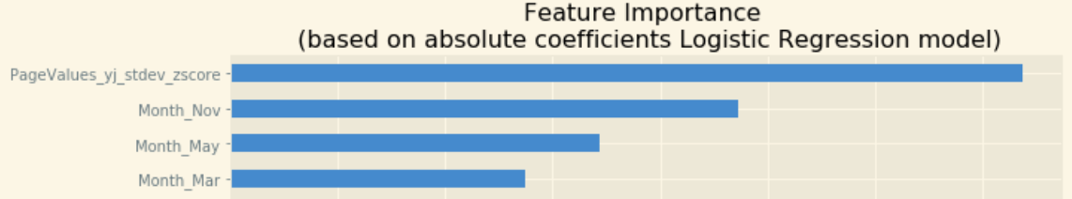
Sub Question 4: Does seasonality play a role in customer’s purchasing decision?
Months
November, May & March
Second half of the year
Q3 & Q4
Special Day
Closer to Special Day, sales increase
Notes:
Yes
Logistic Regression model shows the greatest influence months have on feature importance highest
Second half of the year: Q3 & Q4
Nov, May, Mar → surprised about Dec
Closer to Special day increases sales a small amount → can see a pattern

Slide 23
Main Question: What drives potential customers to make a purchase?
Enhance customers online experience by focusing on…
Administrative Type pages
New visitors because they are highly impressionable
Specific Traffic Types
Second half of the year (Q3 & Q4)
Nov, May & March
Special Day, holidays during peak months
Notes:
Using the tools we built, specifically our Random Forest Model, we are able to conclude…
Need a good experience → a good website has low bounce & exit rates mean
Administrative type pages impact buying behaviors more than other type of pages

Slide 24

Why Your Marketing Team Cares...
Increase your revenue
Improve your company website
Lower exit & bounce rates
Create strong Administrative Related Pages
Increase online presence/digital marketing during targeted months
Understand customers most likely to make a purchase
Target impressionable New Visitors
Target certain Traffic Types
Target customers leading up to certain Special Days
ex: May Graduations
Notes:
Why marketing team cares
Recommendations -- improve website to lower bounce rates, (ex: improve product pgs bc important factor for purchasing)
Browsers x, y, z purchase the most
Can we breakdown our target customer? Include “It’s important to understand your online shoppers”
Take note that operating system and browse type are highly correlated (60%)

Slide 25
Surprising Findings
Administrative pages > Product Pages
Operating System 2 is most used, but Operating System 3 is higher in importance
Importance of March
These features have low importance:
Month December
Region
Weekend
Notes:
The month of december was not an important month feature → assumed with the holiday season it would be higher
Region was very low on the feature importance list across all models
Administrative related pages were higher in importance compared to product pages

Slide 26
Evaluation
Ensemble learning → combine top models
Do not remove outliers for Page Value
Do not need 20+ features in our dataset→ cut to minimal features

Slide 27
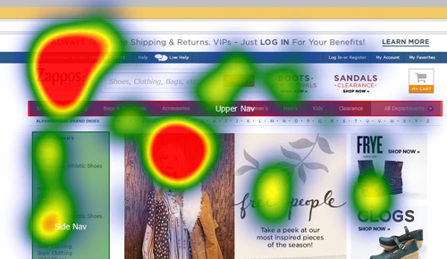
Next Steps for Future Research...
How to improve Administrative & Product Pages
Additional Variables: Graphics/Visuals, Text Content
Pages with a high Page Value (Product Pages) utilize eye tracking
More info about Browser Type
Satisfaction level of customer’s web experience
Transactions, Navigating through different pages
Notes:
In our next round of data collection, we would target…
Test ways marketing teams can improve administrative and product related pages. For example, test for the impact visuals and varying text content has on shopping behaviors
Utilize eye tracking on pages with high Page Value → where are users focusing their attention on
Want more information about traffic type → right now we don’t know what the Traffic Type 3 means
Gather more information from online customers about their online experience, specifically satisfaction level

Slide 28
Questions?

Slide 29
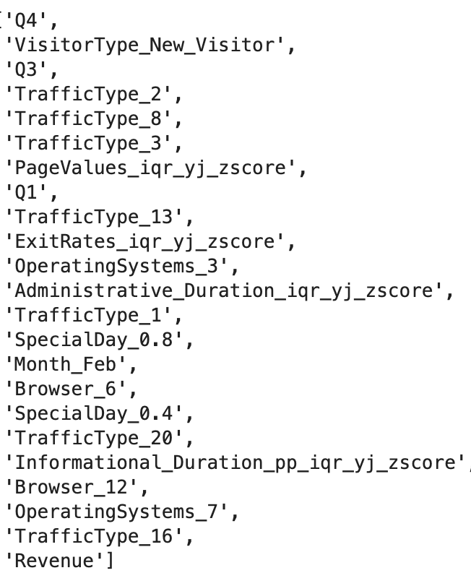
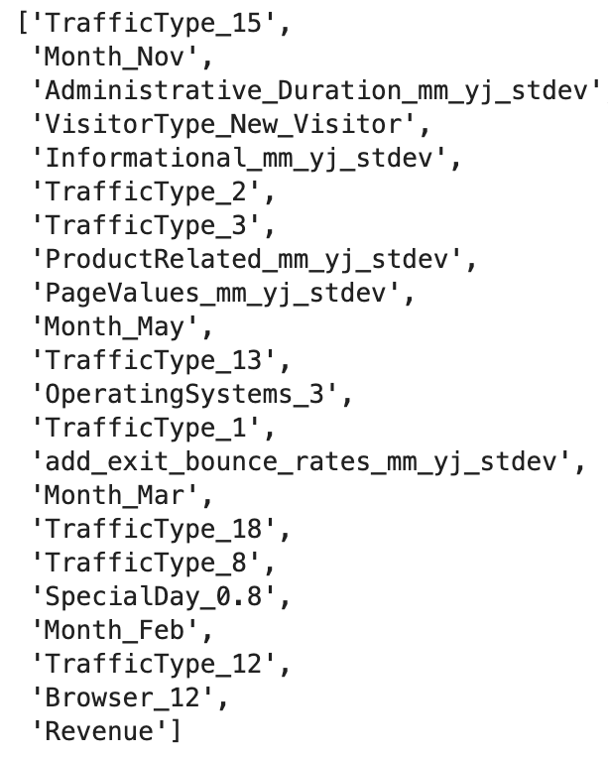
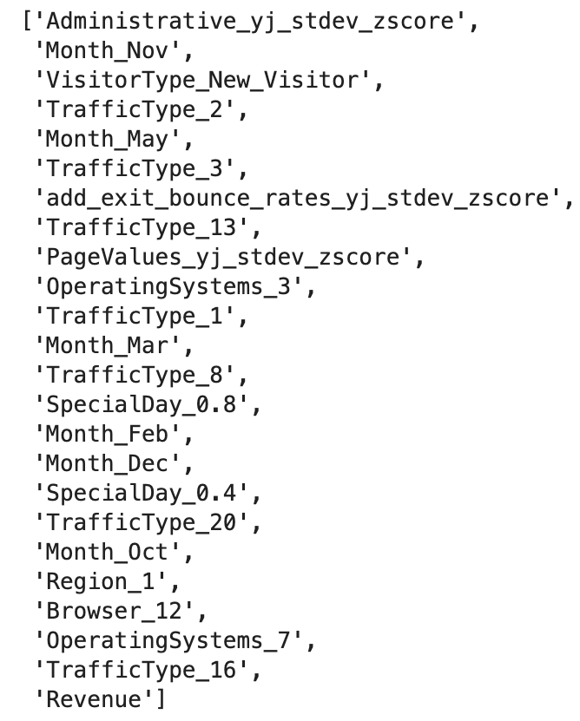
Pipeline 1
Pipeline 2
Pipeline 3

